Slide 1

Flutter

Slide 2
Flutter
Check Box
List View
Radio
Dropdown
Navigation

Slide 3

Check Box
Checkbox(
),
value: true,
onChanged: (bool? newValue) {
// Handle checkbox state change
},

Slide 4
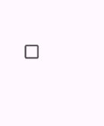
Check Box
bool _isChecked = false;
Checkbox(
),
value: _isChecked ,
onChanged: (bool? newValue) {
_isChecked=newVAlue!;
setState((){});
},

Slide 5
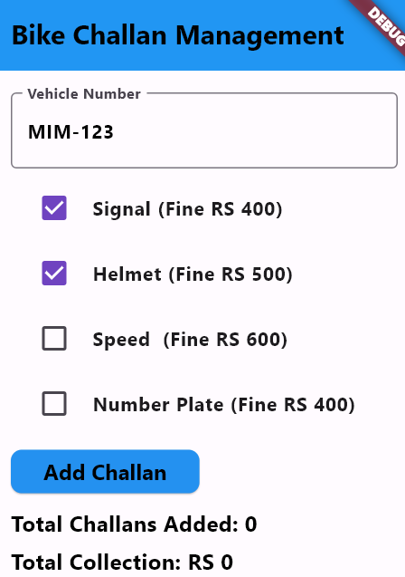
Check Box

Slide 6
List View

Slide 7
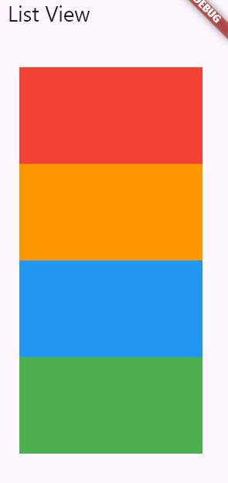

List View
ListView(
)
children: [
Container(color: Colors.red,height: 100,width: 100,),
Container(color: Colors.orange,height: 100,width: 100,),
Container(color: Colors.blue,height: 100,width: 100,),
Container(color: Colors.green,height: 100,width: 100,),
],

Slide 8
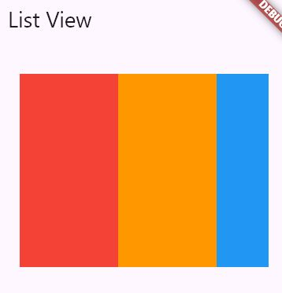
List View
ListView(
)
scrollDirection: Axis.horizontal,
children: [
Container(color: Colors.red,height: 100,width: 100,),
Container(color: Colors.orange,height: 100,width: 100,),
Container(color: Colors.blue,height: 100,width: 100,),
Container(color: Colors.green,height: 100,width: 100,),
],

Slide 9
List View builder
ListView.builder(
itemCount: 10,
)

Slide 10
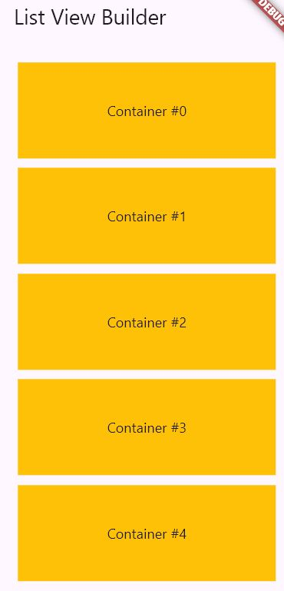
List View builder
ListView.builder(
itemCount: 10,
itemBuilder: (BuildContext context,int index){
},
)
return Container(
height: 100,
width: 100,
color: Colors.amber,
margin: EdgeInsets.all(5),
child: Center(child: Text('Container #${index}')),
);

Slide 11
Radio Button

Slide 12
Radio button
Radio(
)
value: value,
groupValue: groupValue,
onChanged: onChanged

Slide 13
Radio button
Radio(
)
"Male"
"M"
1
value: ,
groupValue: groupValue,
onChanged: onChanged

Slide 14
Radio button
Radio(
)
"Male"
value: ,
groupValue: "Male",
onChanged:
(String? val){
}
Radio button will be selected if value and group value is same

Slide 15
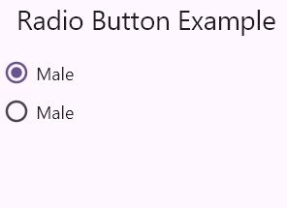
Radio button
String? _groupVal;
Row(
children: [
Radio(
value: "Male",
groupValue: _groupVal,
onChanged: (String? val){
setState((){_groupVal=val});
}
), Text('Male')
],
)
Row(
children: [
Radio(
value: “Female",
groupValue: _groupVal,
onChanged: (String? val){
setState((){_groupVal=val});
}
), Text('Male')
],
)

Slide 16
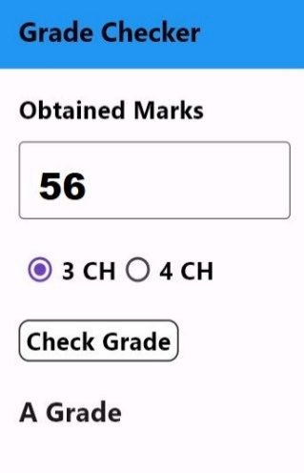
Radio button
Consider a give UI for grade checking. You are required to write a code for check grade button. On button click calculte and display respective grade on label as shown in UI. Grade is depenedent on credit hour and marks obtianed. Criteria is given below
Grade | 3 CH | 4CH
A | Marks > 47 | Marks > 63
B | 38 < Marks < 48 | 51 < Marks < 64
C | 29 < Marks <39 | 39 < Marks < 52
D | 23 < Marks > 30 | 31 < Marks < 40
F | Marks < 24 | Marks < 32

Slide 17
DropdownButton

Slide 18
DropdownButton
DropdownButton(
)
List<DropdownMenuItem<T>>?
items:
onChanged:
void Function(dynamic)?

Slide 19
DropdownButton
List<DropdownMenuItem<T>>?
String ?selectedValue;
DropdownButton(
)
getMenuItems()
items:
onChanged:
void Function(String?)?
(String ? value){ }
(String ? value){selectedValue=value }
Item 1
Item 2
value:
selectedValue
List<DropdownMenuItem<String>> getMenuItems()
{
}
List<DropdownMenuItem<String>> menuItems = [
];
Assume that you have selected Item 2, It wont be visible in dropdown as selected item.
DropdownMenuItem(value: "Item 1", child: Text("Item 1")),
DropdownMenuItem(value: "Item 2", child: Text("Item 2")),
return menuItems;

Slide 20
DropdownButton
String ?selectedValue;
List<String> items = ["Item 1", "Item 2", "Item 3"];
DropdownButton(
)
items.map((String item) {
}).toList(),
items:
onChanged:
return DropdownMenuItem(
value: item,
child: Text(item),
);
(String ? value){ selectedValue=value; },
value:
selectedValue

Slide 21
Example
Color Selection
Select Color:
White
Orange
Yellow
Red
Purple
Green
White

Slide 22
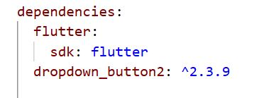
DropdownButton
DropdownButton2<String>(
)
hint: Row(
children: [
Icon(Icons.list, size: 20, color: Colors.grey),
SizedBox(width: 8),
Text('Select Fruit', style: TextStyle(fontSize: 16, color: Colors.grey), ),
],
),
buttonStyleData: ButtonStyleData(
height: 50, width: 200,
padding: EdgeInsets.symmetric(horizontal: 14),
decoration: BoxDecoration(
borderRadius: BorderRadius.circular(14),
border: Border.all(color: Colors.deepPurple),
color: Colors.deepPurple.shade50, ),
elevation: 2,
),

Slide 23
DropdownButton
DropdownButton2<String>(
)
iconStyleData: IconStyleData(
icon: Icon(Icons.arrow_drop_down, color: Colors.deepPurple),
iconSize: 24, ),
dropdownStyleData: DropdownStyleData(
maxHeight: 200,
width: 200,
decoration: BoxDecoration(
borderRadius: BorderRadius.circular(14),
color: Colors.white,
),
elevation: 4,
offset: Offset(0, -5),
),
menuItemStyleData: MenuItemStyleData(
height: 40,
padding: EdgeInsets.symmetric(horizontal: 14),
),

Slide 24
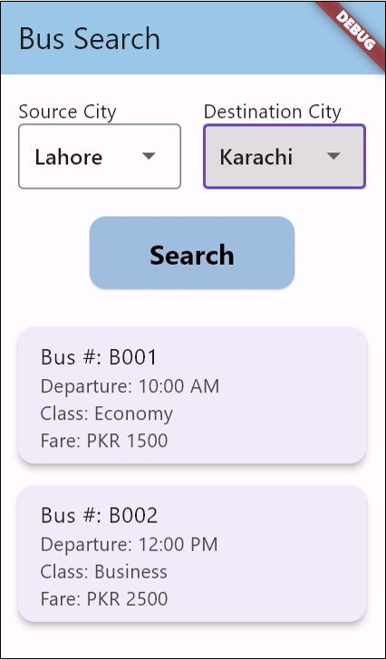
Example

Slide 25
Navigation
Navigator.push(
);
Screen 2
Screen 1
Screen 2
context,
MaterialPageRoute(
)
builder: (context){
}
Screen 2
Move to Screen 2
return Screen2();
Screen 2

Slide 26
Passing Data from one screen to another (Stateless)
Login Screen
Dash Board
class DashBoardScreen extends StatelessWidget{
String username;
DashBoardScreen({required this.username});
Widget build(BuildContext context){
return Scaffold(
body:Center(Text(username))
);
}
}
Ali
Welcome Ali
*****
Login
Navigator.push(
context, MaterialPageRoute(
builder: (context){
return DashBoardScreen(username:username.text);
}
)
);

Slide 27
Passing Data from one screen to another (Stateful)
Login Screen
Dash Board
class DashBoardScreen extends StatefulWidget{
String username;
DashBoardScreen({required this.username});
State<StatefulWidget> createState(){
return _DashBoardScreenState();
}
}
Ali
Welcome Ali
*****
class _DasbBoardScreenState extends State<DashBoardScreen>
{
Widget build(BuildContext context){
return Scaffold(
body: Center(
child:
)
);
}
}
Login
Text(widget.username)
Text(username)
Navigator.push(
context, MaterialPageRoute(
builder: (context){
return DashBoardScreen(username:username.text);
}
)
);

Slide 28
Stack

Slide 29
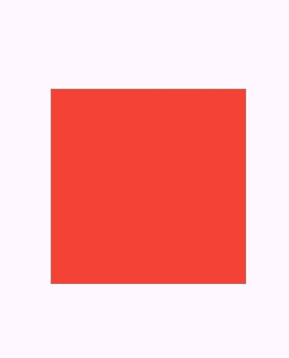
Stack
Stack(
children: [
Container(
width: 200,
height: 200,
color: Colors.blue,
),
Container(
width: 200,
height: 200,
color: Colors.green,
),
Container(
width: 200,
height: 200,
color: Colors.red,
),
],
),

Slide 30

Stack
Stack(
children: [
Container(
width: 200,
height: 200,
color: Colors.blue,
),
Container(
width: 150,
height: 150,
color: Colors.green,
),
Container(
width: 100,
height: 100,
color: Colors.red,
),
],
),

Slide 31
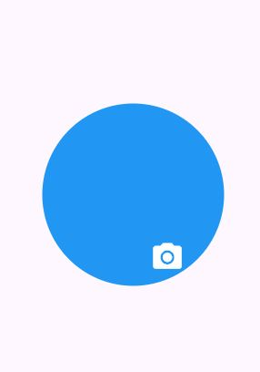
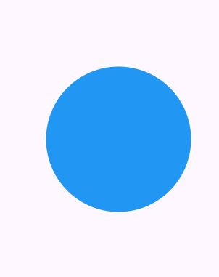

Stack
Stack(
children: [
],
),
CircleAvatar(
radius: 80,
backgroundColor: Colors.blue,
),
Positioned(
top: 120,
right: 35,
child: Icon(
Icons.camera_alt,
size: 30,
color: Colors.white,
),
),
Icon( Icons.camera_alt, size: 30,
color: Colors.white,
),

Slide 32
Asynchronous Methods

Slide 33
Asynchronous Methods
An asynchronous method allows a program to perform other work while waiting for a time-consuming operation (like fetching data, reading a file, or calling an API) to finish instead of blocking the main thread. This improves responsiveness and performance, especially in UI or networked applications.
To make function asynchronous async keyword is used
async
await
Future

Slide 34
Asynchronous Methods
void asynchTest()async
{
print("Start of asynchTest");
// Simulating a delay using Future.delayed
await Future.delayed(Duration(seconds: 2), () {
print("Inside Future.delayed");
});
print("End of asynchTest");
}
void main() {
print("Before calling asynchTest");
// Calling the asynchronous function
asynchTest();
print("After calling asynchTest");
}
Before calling asynchTest
Start of asynchTest
After calling asynchTest
Inside Future.delayed
End of asynchTest

Slide 35
Asynchronous Methods
int getDataFromAPI()async
{
}
Asynchronous Methods should return Future.

Slide 36
Asynchronous Methods
Future<int> getDataFromAPI()async
{
}
States of a Future: A Future can be in one of three states:
Uncompleted: The asynchronous operation is still in progress, and the value or error is not yet available.
Completed with a value: The operation has finished successfully, and the Future holds the resulting value.
Completed with an error: The operation encountered an error, and the Future holds the error information.

Slide 37
Future
Future<int> getDataFromAPI()async
{
}
Random random = Random();
await Future.delayed(Duration(seconds: 3));
int randomNumber = random.nextInt(100);
if(randomNumber % 2 == 0)
{
return randomNumber;
}
else
{
throw Exception('Failed to fetch data from API');
}
await can be written only in async methods
int x=
await
getDataFromAPI();
.then(
)
getDataFromAPI()
(value) {
print('Data fetched successfully: $value'); }
. catchError( (error) {
print('Error occurred: $error');}
);

Slide 38
Pick Image from Camera
image_picker: ^1.2.0
Step 1: Create object of ImagePicker class
ImagePicker picker = ImagePicker();
Step 2: use pickImage method
XFile? photo = await picker.pickImage(source: ImageSource.camera);
Step 3: Create File from XFile
Step 4: Create Image widget
File file = File(photo.path);
Image.file( file );

